Slide 1


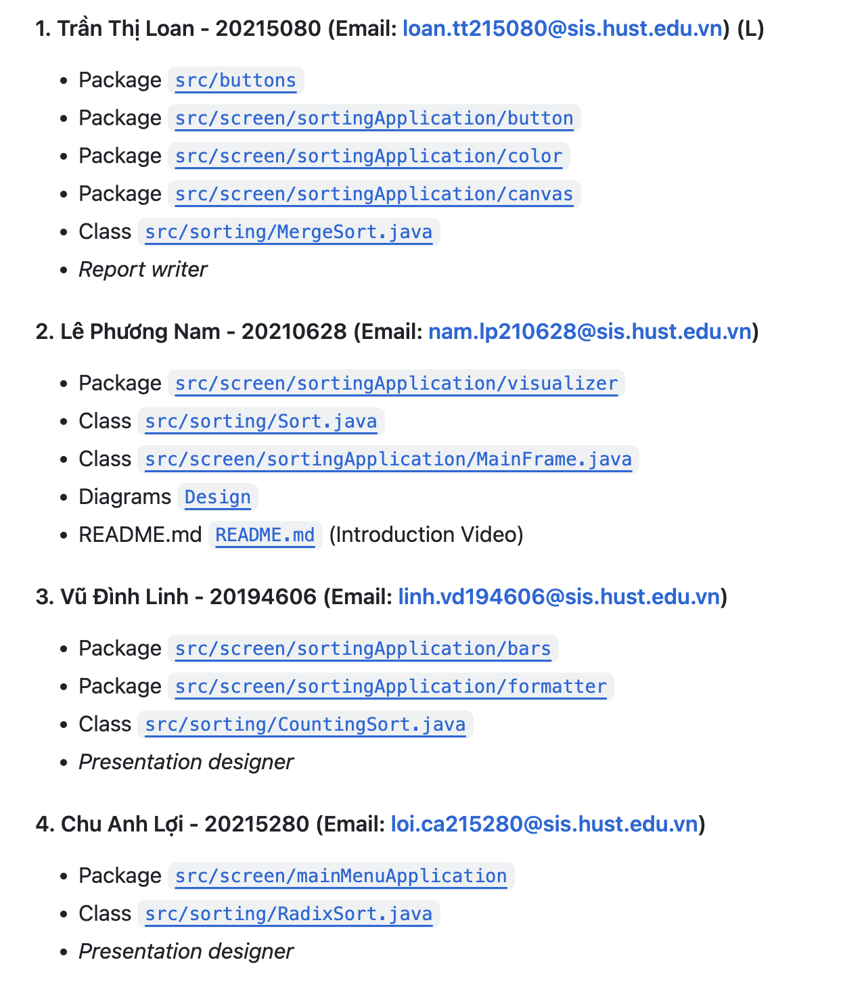
TEAM 19
6TH GRADE
Assignment of members

Slide 2


TOPIC:
Demonstration of sorting
algorithms on an array
PROBLEM: Explain three sorting algorithms: Merge sort, Counting sort, Radix sort.
REQUEST:
- Visualize sorting algorithms on an array, making them become more intuitive.
- MUST use a pure array for this project. If using any Java implementations, must design wrapper to show OOP design in the project.

Slide 3
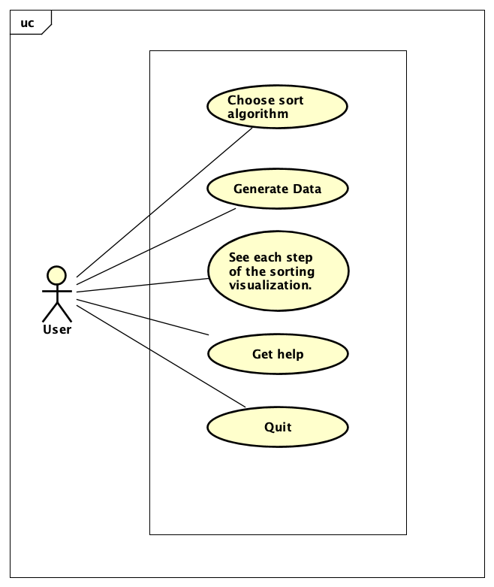
Use case diagram
- Choose sort algorithm: Allow the user to choose an algorithm to sort with an array.
- Generate data : Allow the user to create a random array
- Sorting visualization: GUI, run the designated algorithm, run/reset the visualization, see the steps in the sorting process,...
- Get help: Show the user manual and application restriction to the user under.
- Quit: Backward to the main menu where to choose sorting algorithms.

Slide 4
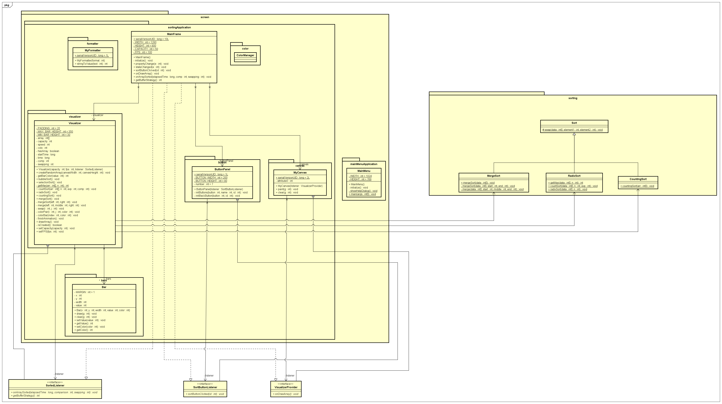
General class diagram

Slide 5
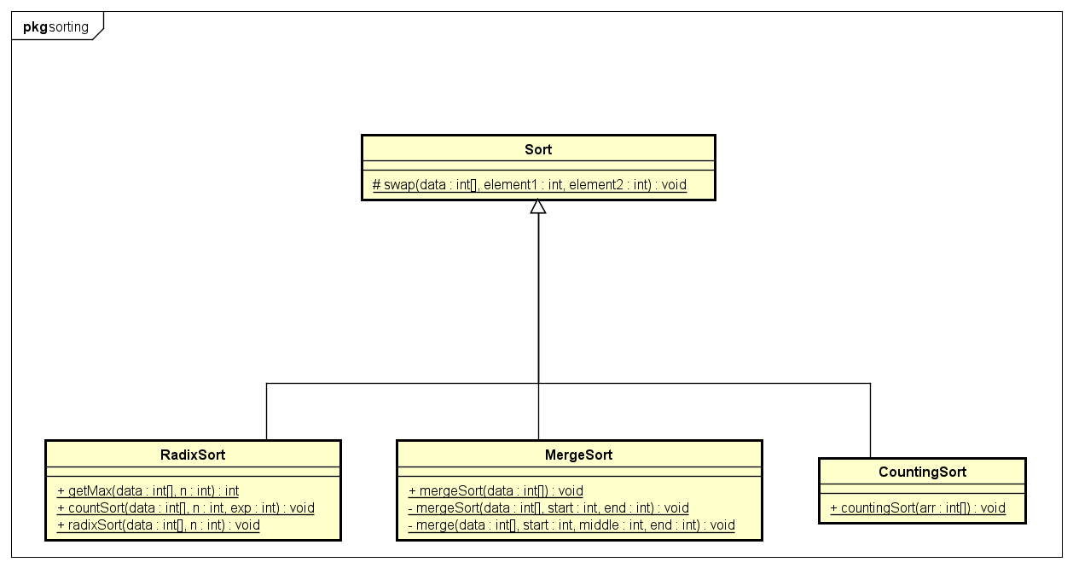
Pakage sorting

Slide 6
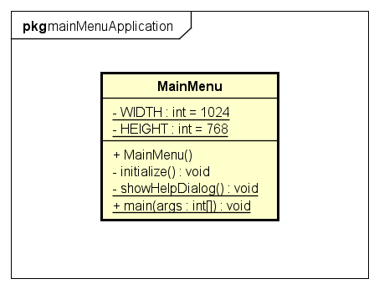
Pakage mainMenuApplication

Slide 7
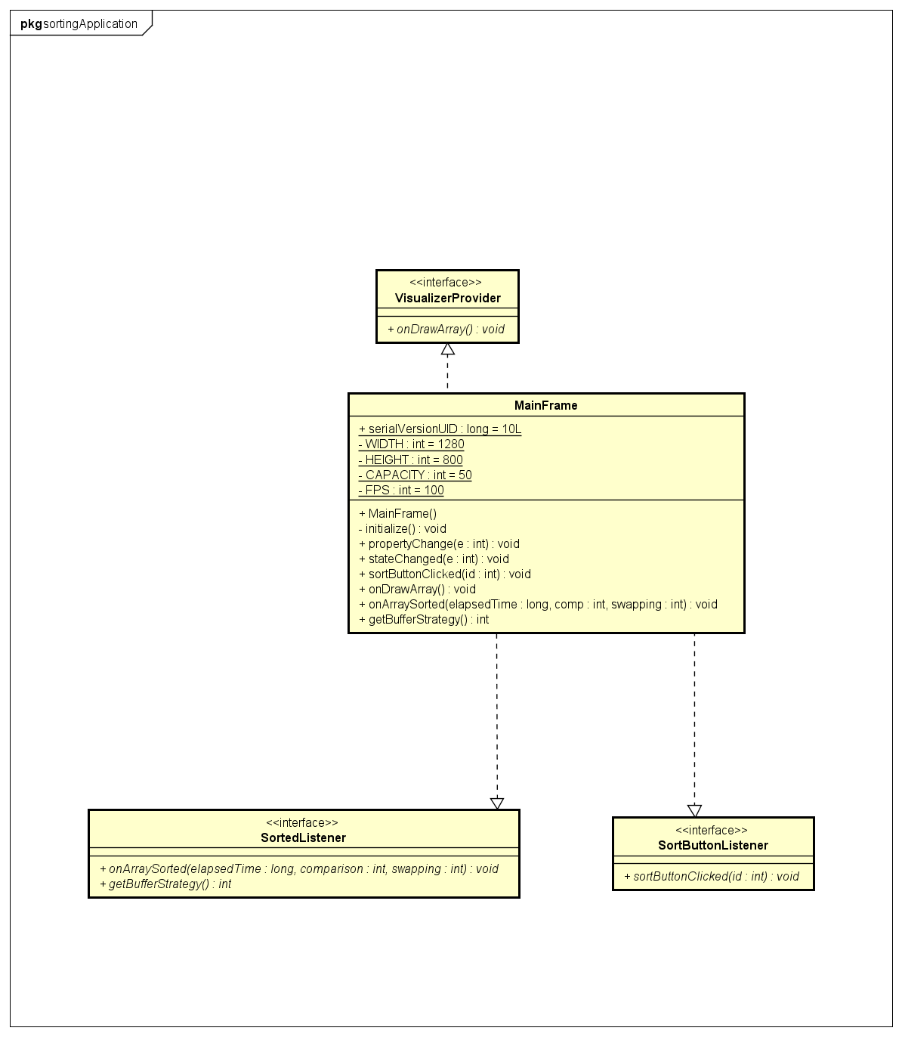
Class MainFrame

Slide 8
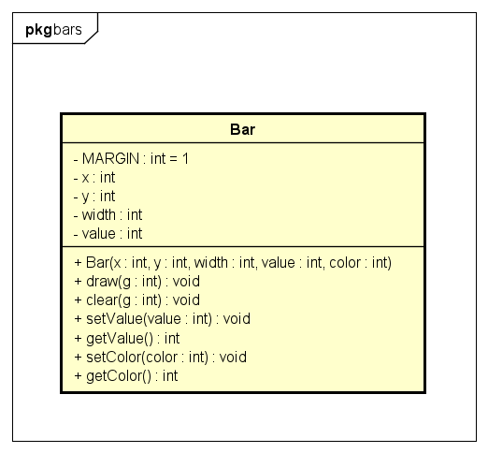
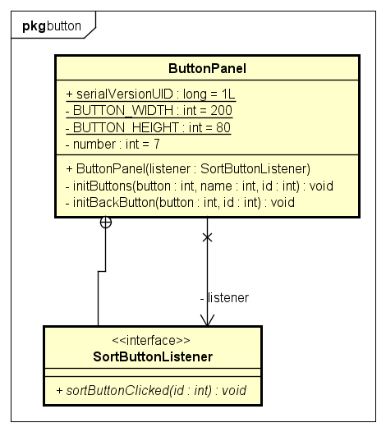
Pakage button
Pakage bars

Slide 9
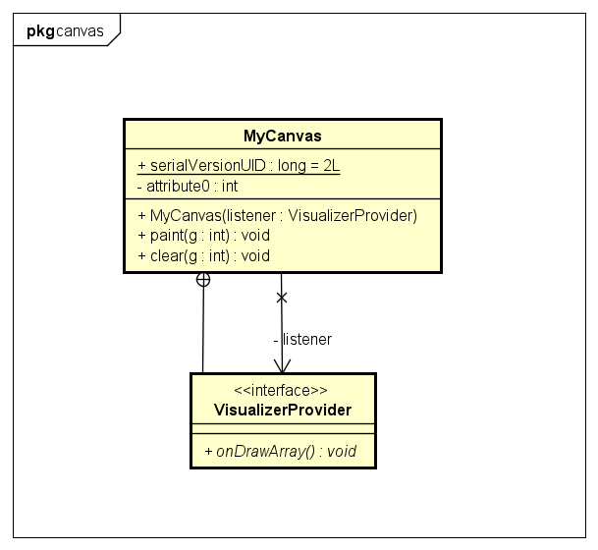
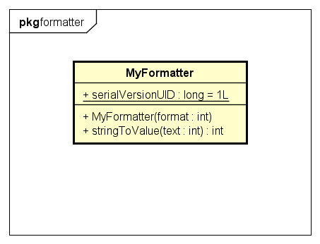
Pakage canvas
Pakage formatter

Slide 10
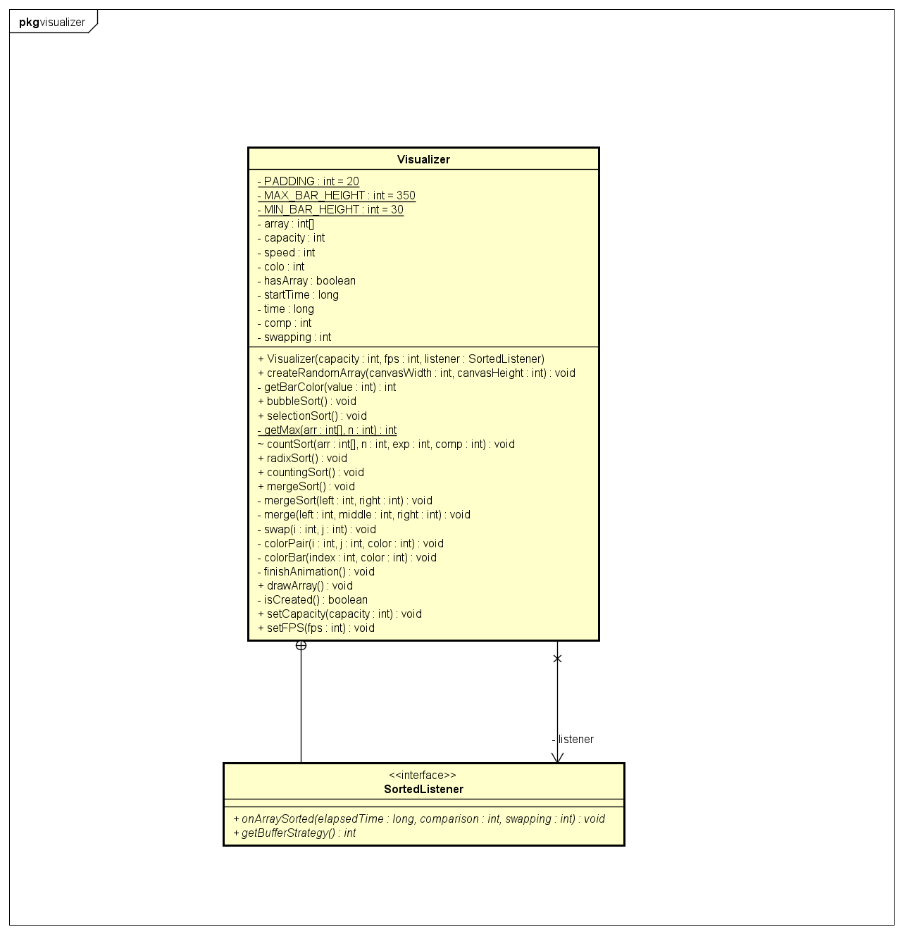
Pakage visualizer

Slide 11
OOP TECHNIQUES
01 - Inheritance
- MergeSort, CountingSort, RadixSort inherit from Sort
- MyFormatter inherit from javax.swing.text.NumberFormatter
- ButtonPanel inherit from javax.swing.JPanel - MyCanvas inherit from java.awt.Canvas - Mainmenu,MainFrame inherit from javax.swing.JFrame
02 – Polymorphism, Overriding
- RadixSort, MergeSort, CountingSort override sort() method of abstract class Sort
- MyCanvas overrides paint() method of java.awt.Canvas
- MyFormatter overrides stringToValue() method of javax.swing.text.InternationalFormatter

Slide 12
OOP TECHNIQUES
03 - Aggregation
- Visualizer has-a Bar
- Visualizer use-a CreateArrayButton, SelectSortTypeButton, …
- MainMenu has-a MainFrame(Sorting windows)
04 - Interface
- ButtonPanel interacts with MainFrame via the SortButtonListener interface - MyCanvas interacts with MainFrame via the VisualizerProvider interface
- Visualizer interacts with MainFrame via the SortedListener interface

Slide 13
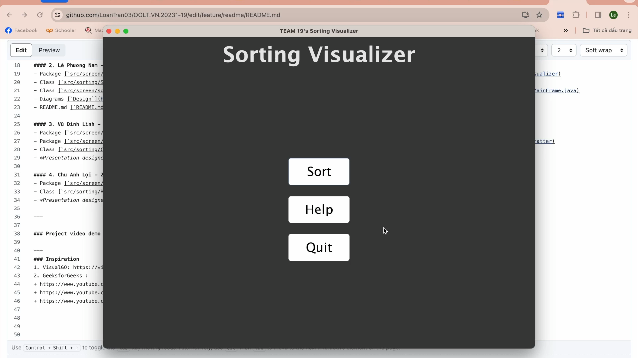
DEMO

